Slide 1

SUNLOVE

Slide 2

BRIEF HISTORY OF SUNLOVE HOME
In 1986, founding member Mr. Wee Lin converted an unused chicken farm, to a makeshift home to house 20 psychiatric patients.
From that time onwards, the Home moved to Trafalgar Home converted and refurbished to take in mentally infirmed patients.
Year 2000, Sunlove was given a land to build new home with new facilities. 90% of the building project funded by the Ministry of Health.
Finally in 15th January 2005, residents were relocated to the new building and where operations commenced.

Slide 3
BRIEF HISTORY OF SUNLOVE HOME
2013
The leasing of the land for Surya Home ended. Singapore Land Authority (SLA) reclaimed for land for other structural services.
15 January 2014
Residents of Surya Home was relocated temporarily at Sunlove Home @IMH and Sunlove Home @SILRA.

Slide 4
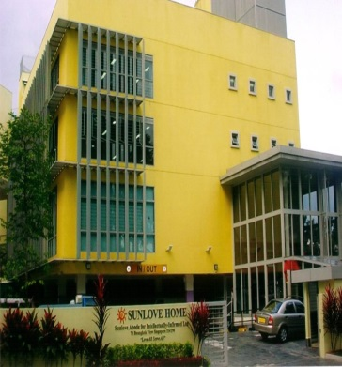
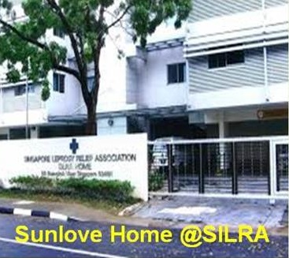
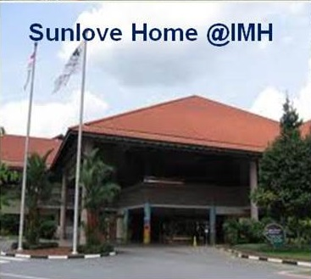
SUNLOVE
HOME
SUNLOVE HOME @SILRA
SUNLOVE HOME @IMH

Slide 5
OUR VISION
Love ALL, Serve ALL:
Regardless of ethnicity, religion, social status and health.
OUR VALUES
At the heart of our mission is love and respect for all persons and kindness to every living thing. We are committed to the universal Human Values in our hearts and minds.
OUR MISSION
We are a charitable Home for the intellectually-disabled. We shelter, protect and care for those entrusted to us. We are committed to improve and provide a level of care that endears the universal Human Values for the less fortunate. We initiate and participate in community-based projects that are charitable.

Slide 6
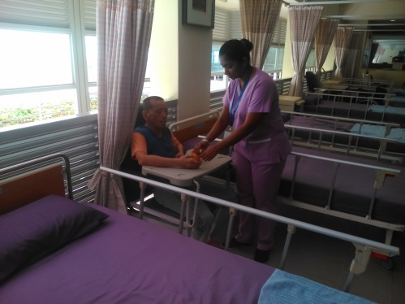
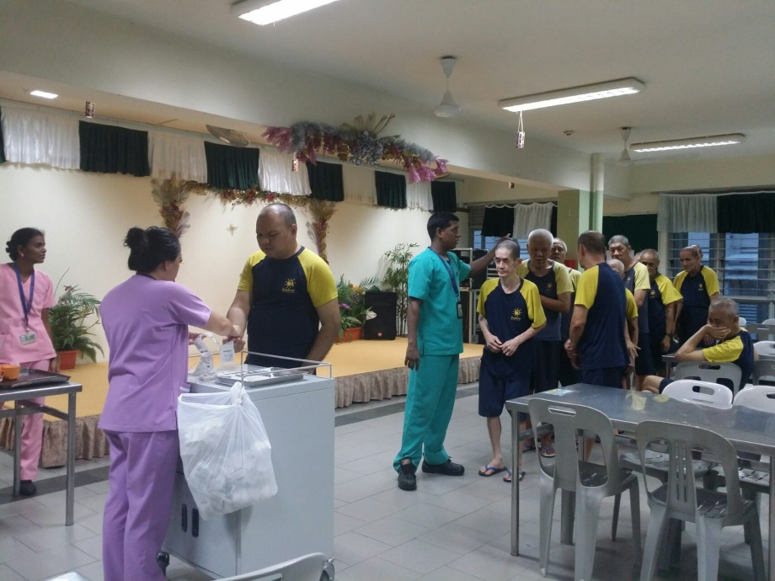
OUR SERVICES FOR PSYCHIATRIC RESIDENTIAL CARE
Nursing Care & Medical Treatment

Slide 7
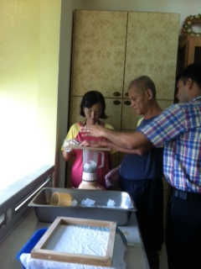
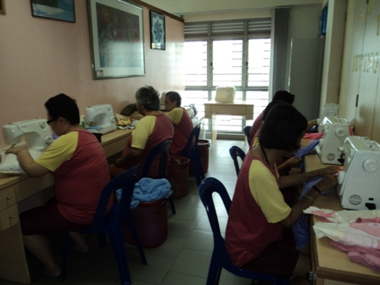
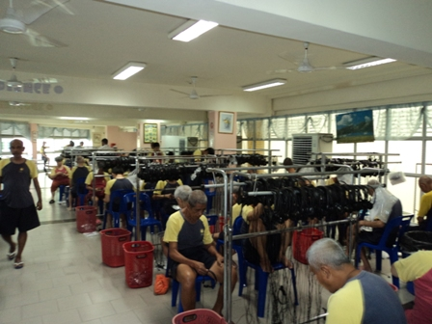
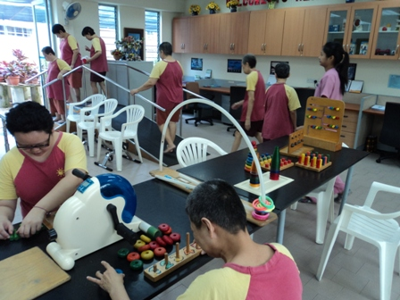
REHABILITATIVE PROGRAMME FOR THE RESIDENTS

Slide 8
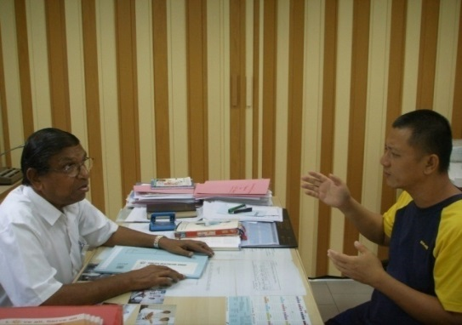
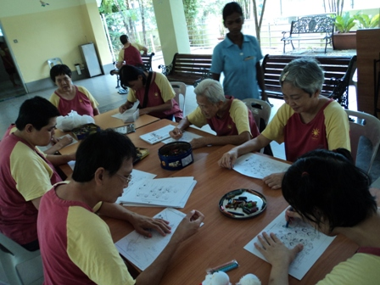
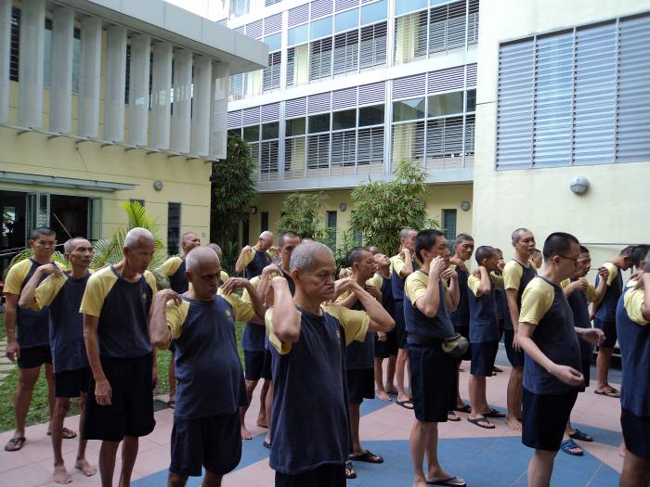
REHABILITATIVE PROGRAMME FOR THE RESIDENTS

Slide 9
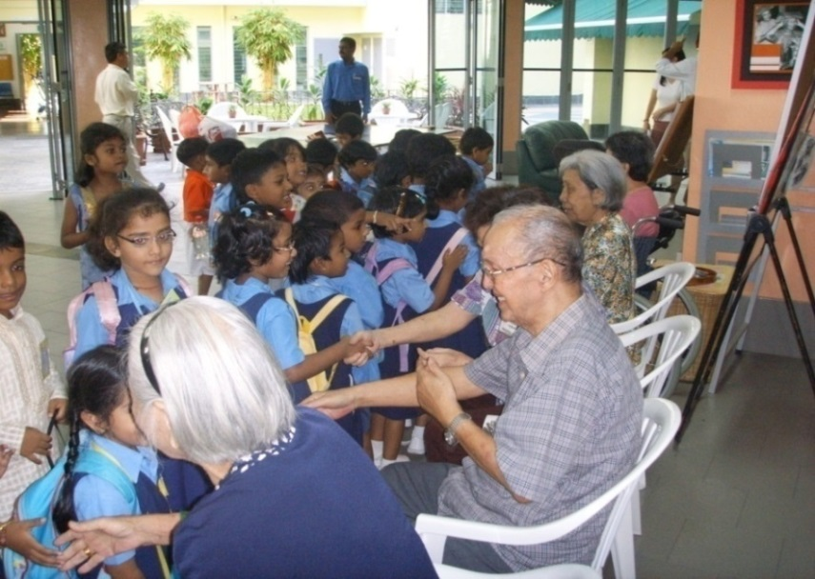
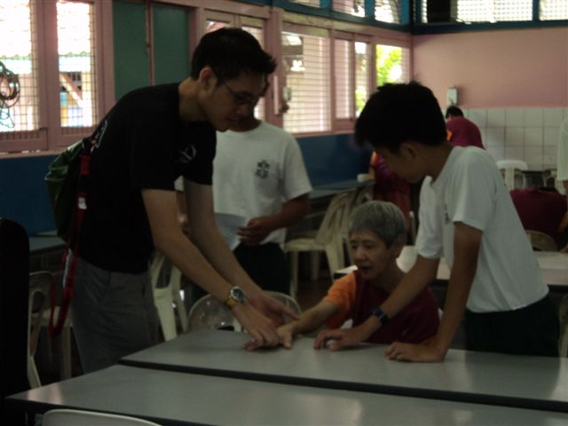
SOCIAL THERAPY
Residents interacting with volunteers

Slide 10
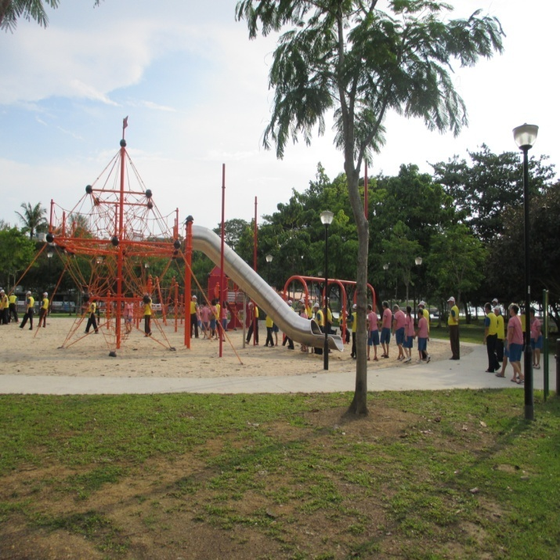
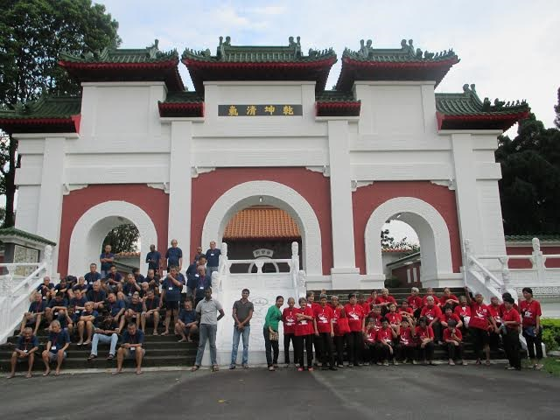
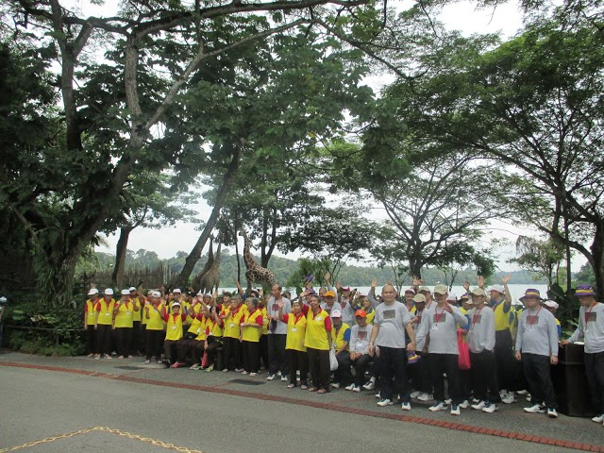
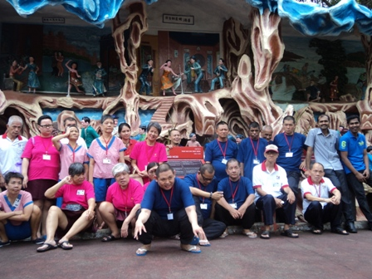
OUTINGS FOR RESIDENTS

Slide 11
Home Medical & Home Nursing/ Home Therapy
Hougang
Eldercare Centre
Sunlove Outreach Programs To The Community
Volunteer Programme
Free Medical Clinics
Home Help Services
Community Health Screening
Bukit Merah Student Care Centre
Ang Mo Kio Rehab Centre
Sunlove COPE @ Eunos
Dementia Daycare Centre
ChaiChee & Marsiling Senior Activity Centre
Maids Training
Teens Training Centre @ Hougang
South East CDC-Home Help Service
Sai Skills Development Centre

Slide 12
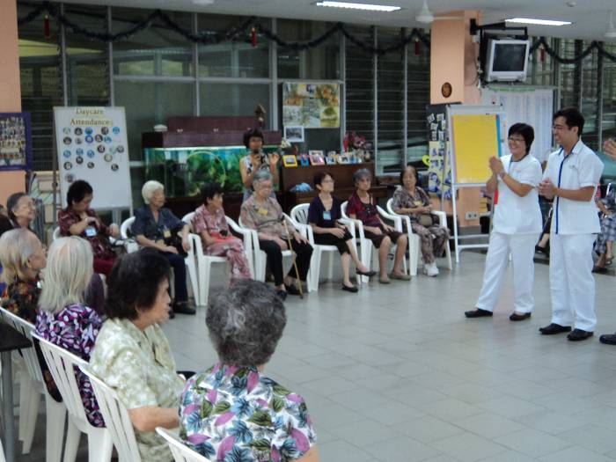
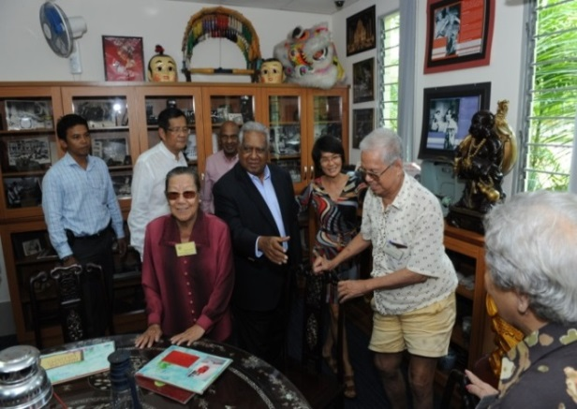
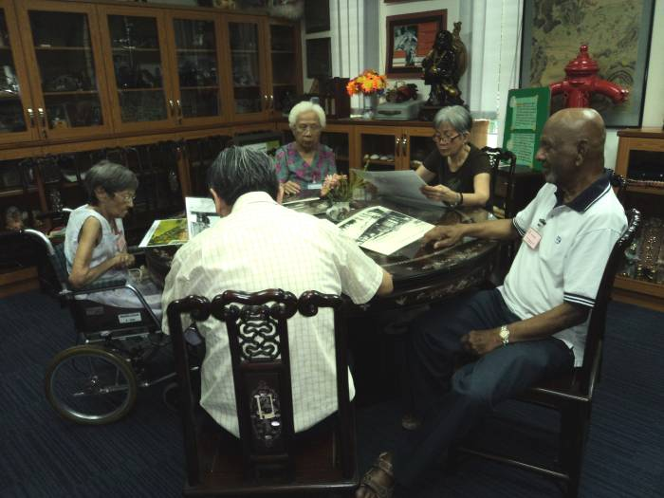
DEMENTIA DAY CARE
Programme
Started in 1997
Caters to elderly clients diagnosed with Dementia.
Door to door transport service.
Activities include physiotherapy and occupational therapy.
Provides support and information to caregivers.

Slide 13
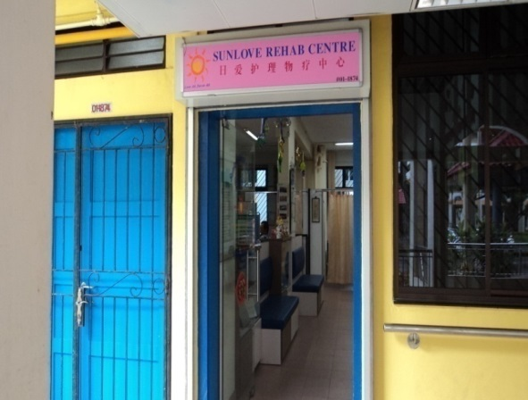
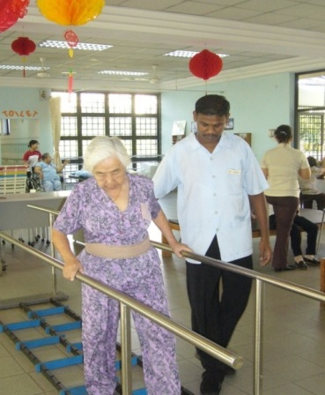
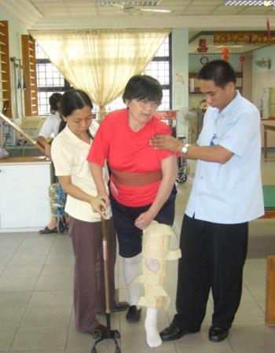
Ang Mo Kio Rehab Centre
Address: Blk 557 Ang Mo Kio Ave 10 Singapore 560557
Started in 2000
Clients – 100
Provides rehabilitative programmes (Occupational Therapy and Physiotherapy) for individuals with physical disabilities such as Stroke, Parkinson’s Disease, Fractures, Neurological Dysfunctions and Geriatric Problems
Home Rehab (Physiotherapy/ Occupational Therapy)
*Boundaries Serve: Hougang, Sengkang, Pungol, Yio Chu Kang, Serangoon, Ang Mo Kio

Slide 14
HOME MEDICIAL & HOME NURSING
Started in 2002
Caters to the Home – Bound elderly.
Age Group: 50 and above.
Provide nursing care and medical treatment to elderly in their homes.
Urinary Catheters
Wound Care
Prevention of pressure sores education
Monitor chronic medical problems
Cases are seen by our doctors and nurses.
*Boundaries Served: Hougang, Yio Chu Kang, Ang Mo Kio, Sengkang, Puggol, Serangoon.

Slide 15
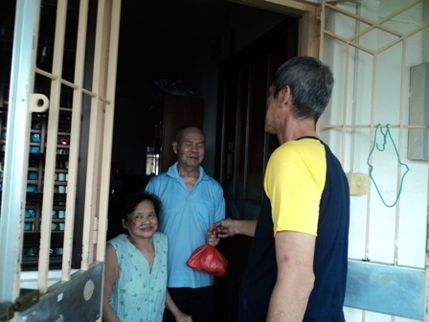
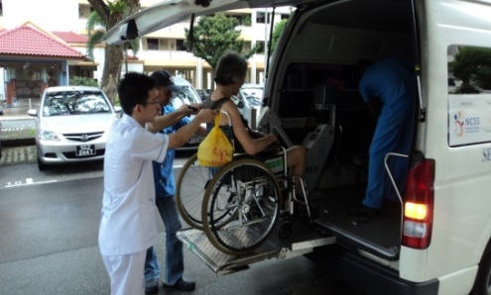
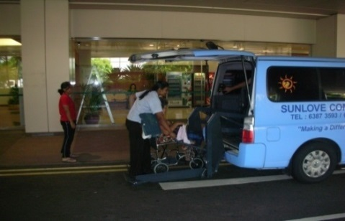
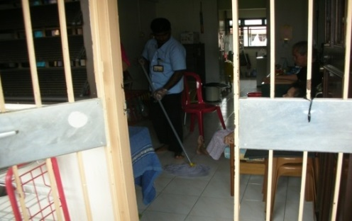
Home Help Services
Accessible and affordable services to assist the frail and homebound elderly.
Launched in 1997
Number of beneficiaries: 500
Services Provided:
Meals on Wheels
Home Maintenance
Personal Hygiene
Laundry Services
Escort Services
*Boundaries Served: Puggol, Hougang, Yio Chu Kang, Ang Mo Kio.

Slide 16
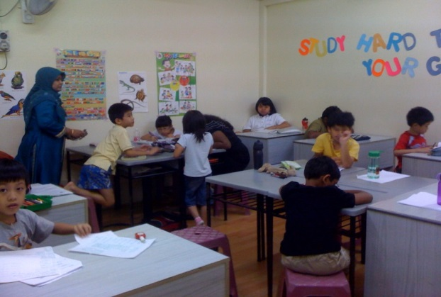
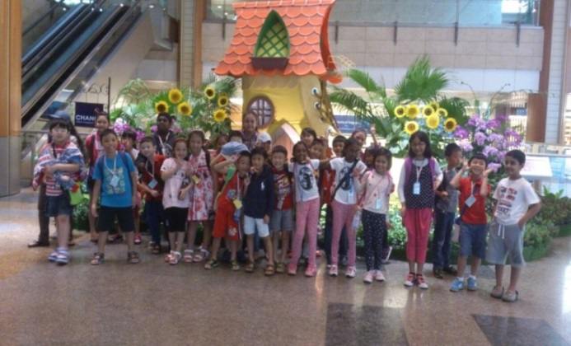
BUKIT MERAH STUDENT CARE CENTRE
Blk 125 Bukit Merah View #01-386
Singapore 151125
DID: 62751302
Our Mission
Our mission is to provide strong, effective education programmes to help students develop healthy life-styles to enhance their intellectual growth and development.

Slide 17
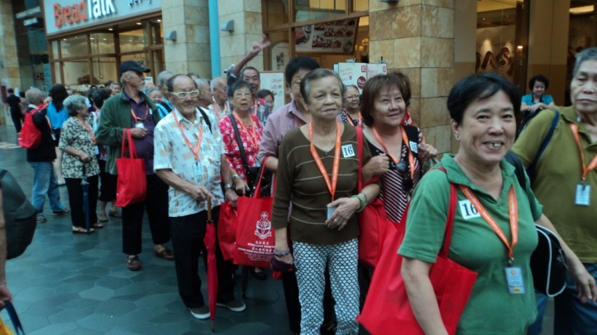
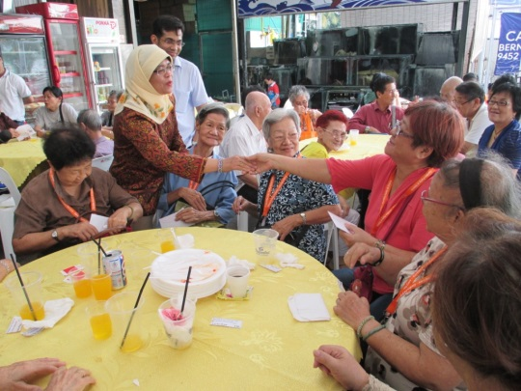
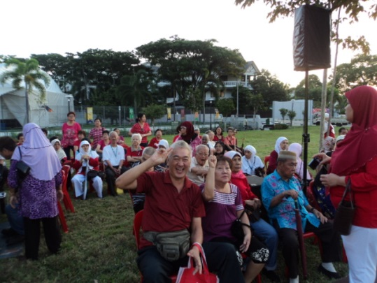
CHAI CHEE AND MARSILING SENIOR ACTIVITY CENTRE
Objectives of Neighbourhood Link:
First stop centre for residents to obtain information on social services, interact form mutual help group.
Social activities and programmes that promote inter-generational bonding:
Targeted Clients – young and old
Approximate no. of clients: 700

Slide 18
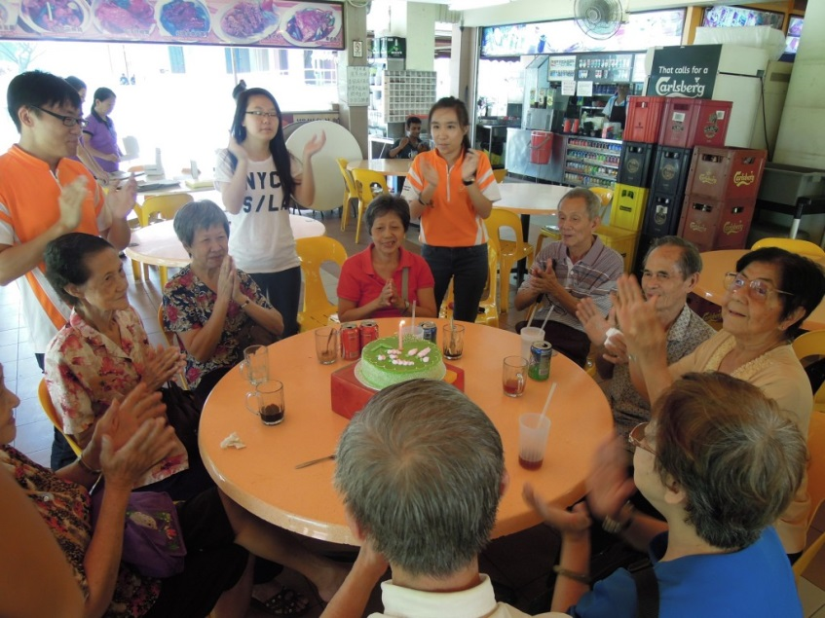
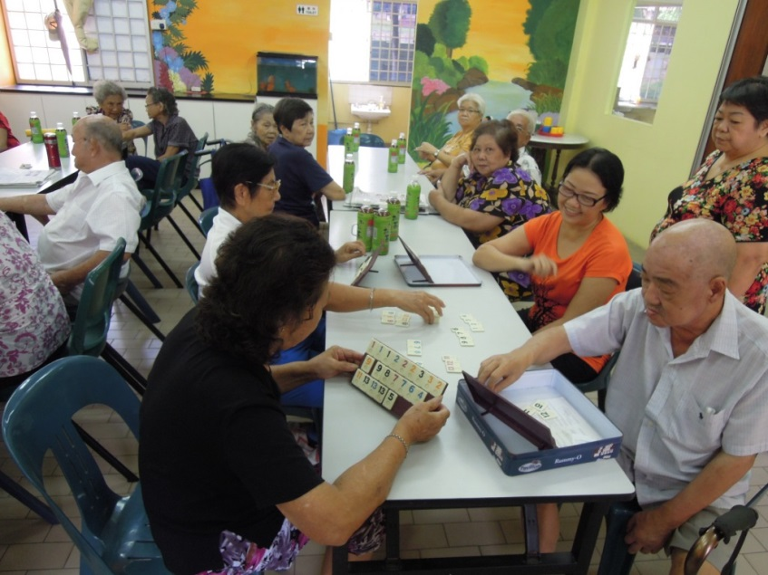
SUNLOVE COPE (EUNOS)
Community Outreach Programmes for Elderly (COPE)
Number of Beneficiaries: 150
Supported By: South East CDC

Slide 19
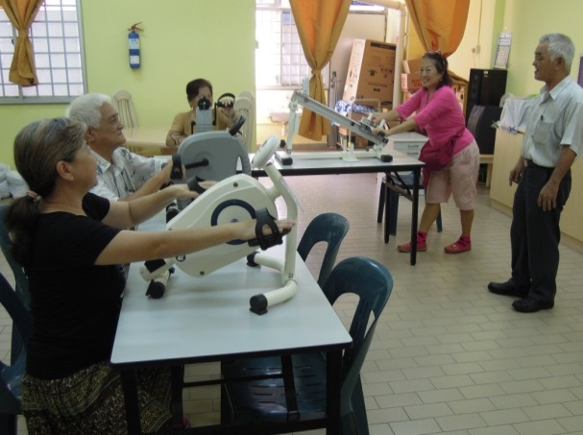
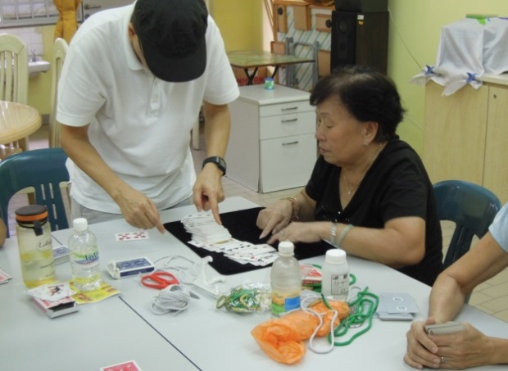
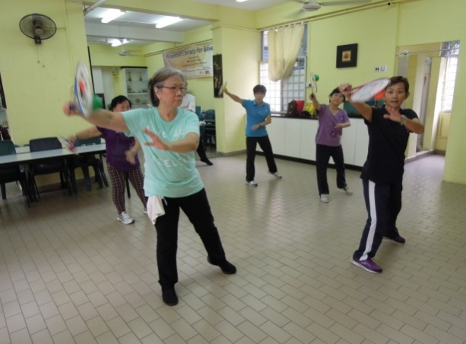
SUNLOVE HOUGANG WELLNESS CENTRE
Started in February 14, 2008
Number of Beneficiaries: 100
Supported by: Hougang CCC and Sunlove
Light Exercise
Magic Session
Taji Rhythmic Ball

Slide 20
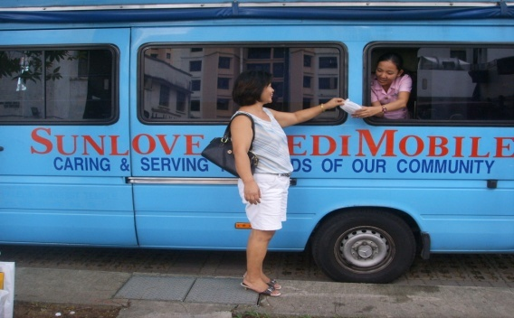
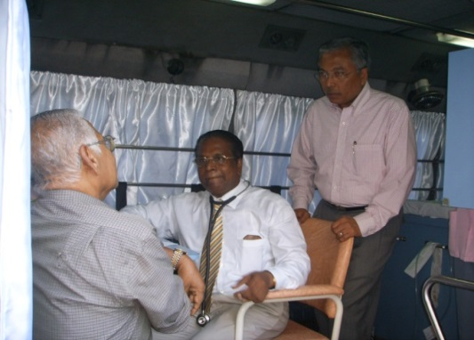
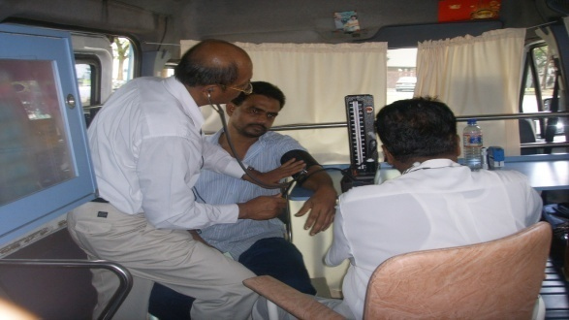
SUNLOVE FREE MEDICAL SERVICES
Serangoon North CC
Chai Chee Neighbourhood Link
Blk 418 Ang Mo Kio (Teck Ghee)
Blk 235 Bukit Batok
Blk 624 Ang Mo Kio Ave 4
Blk 3 Marsiling
Blk 557 Ang Mo Kio Rehab Ave 8
Hougang CC Hougang Ave 3
Blk 10 Eunos Crescent
Jalan Balam RC
Blk 17 Eunos Crescent
Blk 241 Bukit Batok
MKAC
Blk 214 Bukit Batok
Sunlove HQ
Sunlove Home @IMH
Sunlove Home @ SILRA

Slide 21
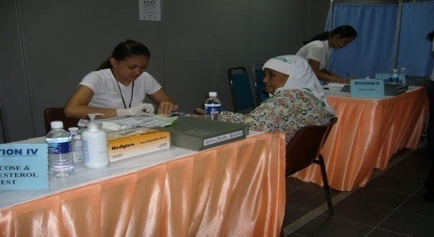
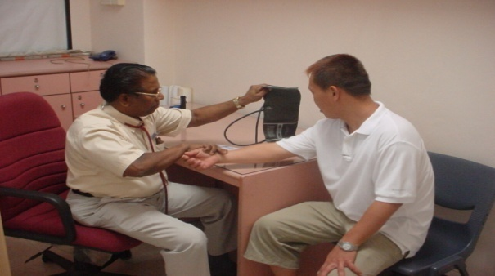
FREE MEDICAL HEALTH SCREENING
Number of Beneficiaries: 5000 over the years
En-naeem Mosque and other Religious Organization
Hougang Community Centre and other Community Centres
Punggol and Teck Ghee
Tao Payoh Indoor Stadium for Senior Citizens Week
Yishun Temple
And many other Community Events

Slide 22
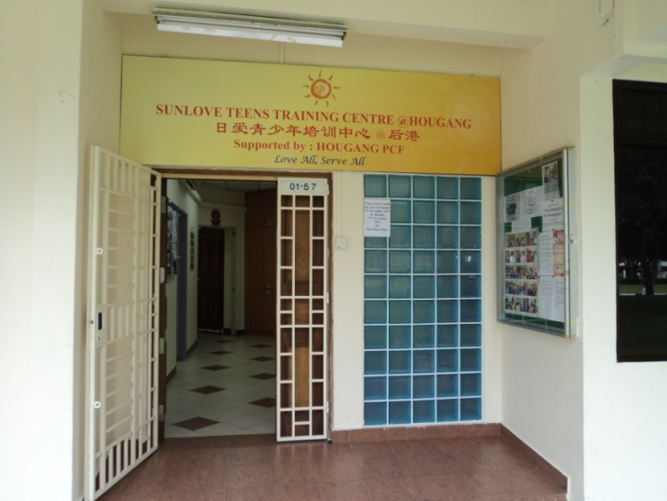
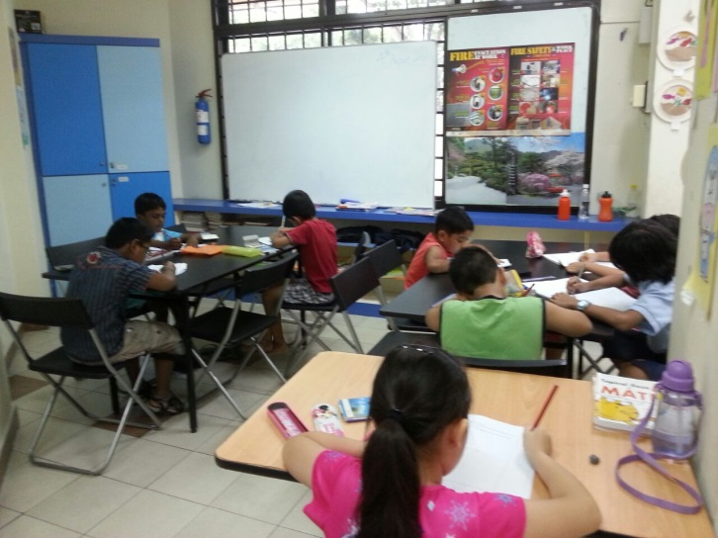
TEENS TRAINING CENTRE @HOUGANG
Address: Blk 708 #01-57 Hougang Ave 2
Singapore 530708
Started in October 1, 2011
Supported by: Hougang PCF

Slide 23
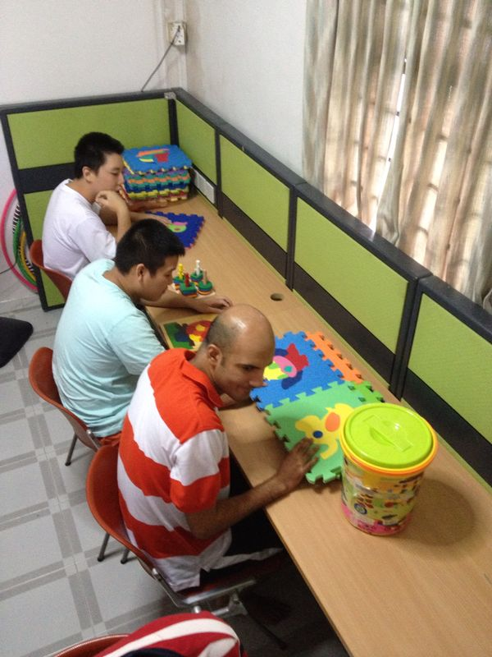
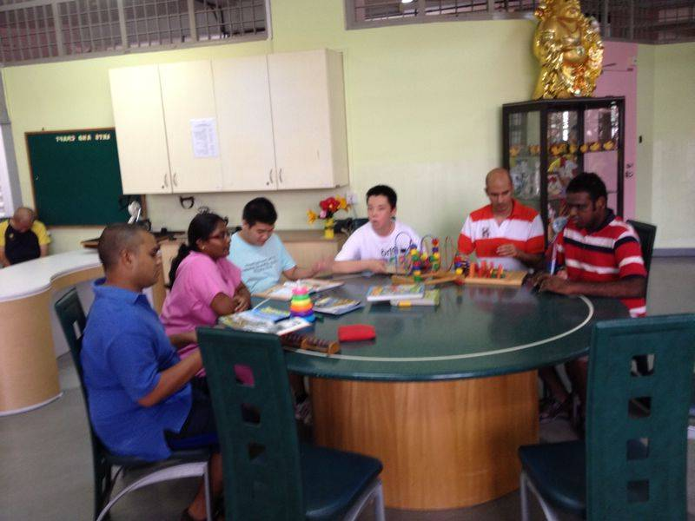
SAI SKILLS DEVELOPMENT CENTRE (AUTISM)
The centre provides services for individuals with Autism

Slide 24
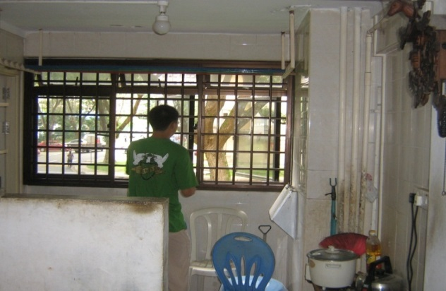
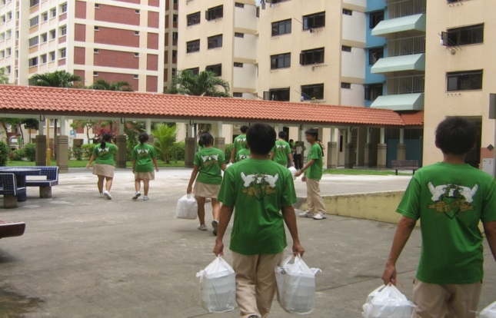
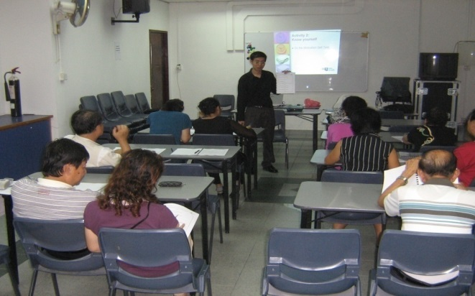
VOLUNTEER PROGRAMME
Students Engaged In Voluntary Work
Provide Training for Volunteers

Slide 25




TRAINING COURSES
For Domestic Workers and Caregivers
In conjunction with Filipino Overseas Workers in Singapore (FOWS) and Oversea’s Skills Program and Services (OSPAS)

Slide 26


SUNLOVE IS AN APPROVED ITE TRAINING CENTRE
Started in 2005
Successfully completed 5 batches
Basic healthcare/ homecare to Health Care Assistants
Conducted by Sunlove ITE Trained Instructors

Slide 27
OTHER SERVICES AT A GLANCE
Case Management Services
Family and Youth Counseling Services
Rental of Rehab Equipment
Ambulance Services
Monthly Food Ration for the Needy Elderly

Slide 28






VISITS BY VIPS

Slide 29
OUR MOTTO
“LOVE ALL,
SERVE ALL”

